Slide 1
Iris Dataset
Presented By
Name : S.Sabik
College name : Jayaraj annapackiam CSI college of engineering
Department : Mechanical engineering

Slide 2
OUTLINE
Problem Statement
Proposed System/Solution
System Development Approach
Algorithm & Deployment
Result
Conclusion
Future Scope
References

Slide 3
Problem Statement
The Iris dataset is a classic dataset in the field of machine learning and statistics. It was introduced by the British statistician and biologist Ronald Fisher in his 1936 paper "The use of multiple measurements in taxonomic problems" as an example of discriminant analysis. The dataset consists of 150 samples of iris flowers, each belonging to one of three species: Setosa, Versicolor, and Virginica.
For each sample, four features are measured: the length and width of the sepals (the green leaf-like structures that protect the flower when it is in bud) and the length and width of the petals. These measurements are in centimeters.
The problem statement usually associated with the Iris dataset is to build a classification model that can accurately predict the species of iris flowers based on their measurements. This is typically approached as a supervised learning problem, where the features (sepal length, sepal width, petal length, and petal width) are used to predict the target variable (species).
Researchers often use the Iris dataset as a benchmark to test the performance of classification algorithms and compare different machine learning models' effectiveness

Slide 4
Proposed Solution
A proposed solution for the Iris dataset typically involves building a classification model that can accurately classify iris flowers into one of the three species (Setosa, Versicolor, or Virginica) based on their measured features (sepal length, sepal width, petal length, and petal width). Here's a step-by-step outline of a common approach:
Data Loading and Exploration: Begin by loading the dataset into your chosen programming environment (e.g., Python with libraries like Pandas and NumPy). Explore the dataset to understand its structure, features, and distributions. Visualize the data using plots such as histograms, scatter plots, or pair plots to gain insights into the relationships between features and species.
Data Preprocessing: Clean the data if necessary by handling missing values, removing duplicates, and dealing with outliers. Ensure that the data is in the appropriate format for modeling, and consider standardizing or scaling the features if needed to improve model performance.
Model Selection: Choose a suitable classification algorithm for the problem. Common choices include logistic regression, decision trees, random forests, support vector machines (SVM), k-nearest neighbors (KNN), and neural networks. Experiment with different algorithms to see which one performs best for the Iris dataset.
Model Training: Split the dataset into training and testing sets to train and evaluate the performance of the model. Optionally, you can also perform cross-validation to assess the model's generalization ability. Train the chosen classification model using the training data.
Model Evaluation: Evaluate the trained model's performance using the testing data. Common evaluation metrics for classification tasks include accuracy, precision, recall, F1-score, and confusion matrix. Compare the performance of the model against baseline models or other algorithms to gauge its effectiveness.

Slide 5
System Approach
A systems approach to tackling the Iris dataset involves breaking down the problem into several interconnected components, each contributing to the overall solution. Here's how you can apply a systems approach to the Iris dataset:
Problem Definition: Clearly define the problem you're trying to solve. In this case, it's classifying iris flowers into one of three species based on their measured features.
Data Acquisition and Preprocessing: Acquire the Iris dataset, ensuring it's complete and clean. Preprocess the data by handling missing values, removing duplicates, and addressing outliers. Additionally, consider standardizing or scaling the features to ensure fair comparisons between them.
Feature Engineering: Analyze the dataset to determine if any additional features could improve model performance. Feature engineering might involve creating new features from existing ones or transforming the data in meaningful ways.
Model Selection and Development: Choose appropriate machine learning models for classification tasks. Experiment with different algorithms such as logistic regression, decision trees, random forests, SVMs, KNN, and neural networks. Develop multiple models and evaluate their performance using suitable metrics.
Model Evaluation and Validation: Assess the performance of each model using techniques like cross-validation and train-test splits. Validate the models' performance using evaluation metrics such as accuracy, precision, recall, F1-score, and ROC curves. Ensure the models generalize well to unseen data.
Model Optimization and Tuning: Fine-tune the selected models by optimizing hyperparameters and conducting parameter tuning. Use techniques like grid search, random search, or Bayesian optimization to find the best hyperparameter settings for each model.
Integration and Deployment: Integrate the trained models into a cohesive system for classification. Develop a user-friendly interface if applicable. Deploy the system in a production environment, ensuring scalability, reliability, and efficiency. Monitor the system's performance and make necessary adjustments over time.

Slide 6
Algorithm & Deployment
Algorithm Development
Several algorithms can be applied to the Iris dataset for classification tasks. Here are some commonly used ones:
Logistic Regression: Despite its name, logistic regression is a linear model for binary classification that can be extended to multiclass classification, making it suitable for the Iris dataset's three-class problem.
Decision Trees: Decision trees partition the feature space into regions and make predictions based on the majority class within each region. They are easy to interpret and can handle both numerical and categorical data.
Random Forests: Random forests are an ensemble learning method that builds multiple decision trees and combines their predictions to improve accuracy and robustness. They are less prone to overfitting compared to individual decision trees.
Support Vector Machines (SVM): SVMs are powerful supervised learning models that can handle both linear and nonlinear classification tasks. They work by finding the optimal hyperplane that separates different classes in the feature space.
k-Nearest Neighbors (KNN): KNN is a non-parametric method that classifies instances based on the majority class of their k nearest neighbors in the feature space. It is simple to implement but can be computationally expensive for large datasets.
Naive Bayes: Naive Bayes classifiers are probabilistic models based on Bayes' theorem with an assumption of feature independence. Despite this simplifying assumption, they often perform well in practice and are computationally efficient.

Slide 7
Deployment
Deploying a machine learning model for the Iris dataset involves making the trained model accessible for making predictions on new data. Here's how you can deploy a model for the Iris dataset:
Serialization: Serialize the trained machine learning model into a file format that can be easily loaded and used for inference. Common serialization formats include pickle for Python-based models or ONNX (Open Neural Network Exchange) for interoperability across different frameworks.
API Development: Create an API (Application Programming Interface) to expose the model's functionality over the web or within an application. You can use frameworks like Flask or Django for developing APIs in Python. Define endpoints for receiving input data and returning predictions.
Scalability: Design the deployment architecture to handle varying levels of traffic and scale efficiently. Consider using cloud services like AWS, Google Cloud Platform, or Microsoft Azure for deploying and scaling your machine learning application.
Input Data Handling: Implement logic for preprocessing input data before passing it to the model for prediction. This may involve tasks such as data normalization, feature scaling, and handling missing values to ensure consistency with the data used during training.
Security: Implement security measures to protect the deployed model and API from potential threats such as unauthorized access, injection attacks, and data breaches. Use authentication mechanisms like API keys or OAuth tokens to control access to the API.
Monitoring and Logging: Set up monitoring and logging mechanisms to track the performance and usage of the deployed model in real-time. Monitor metrics such as latency, throughput, and error rates to ensure the model meets service-level objectives (SLOs).

Slide 8
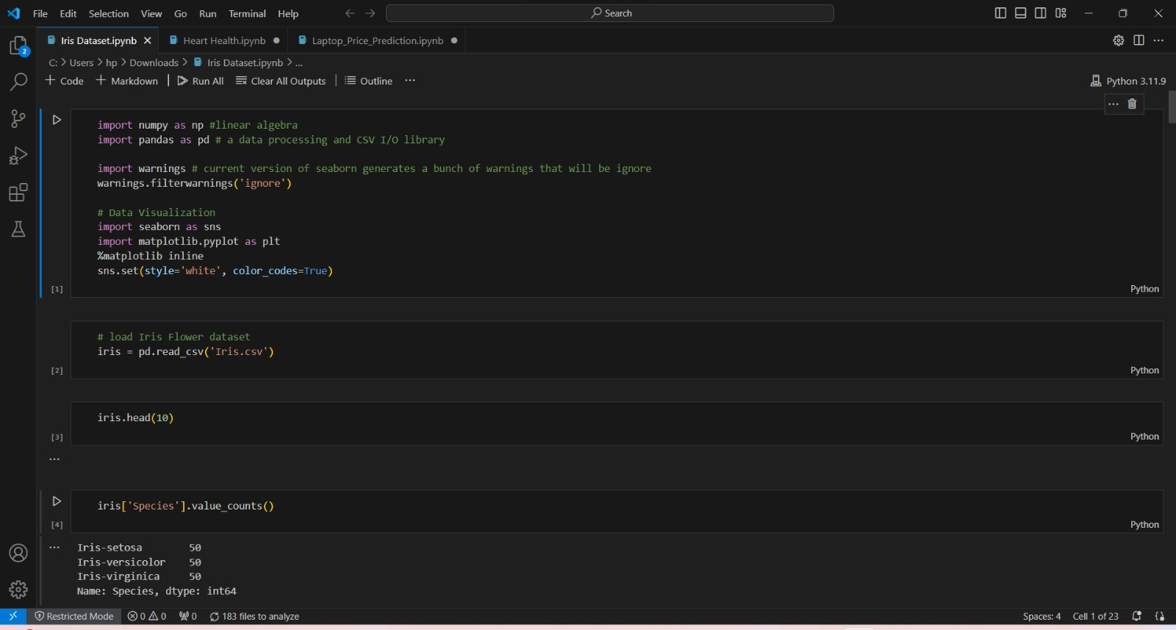
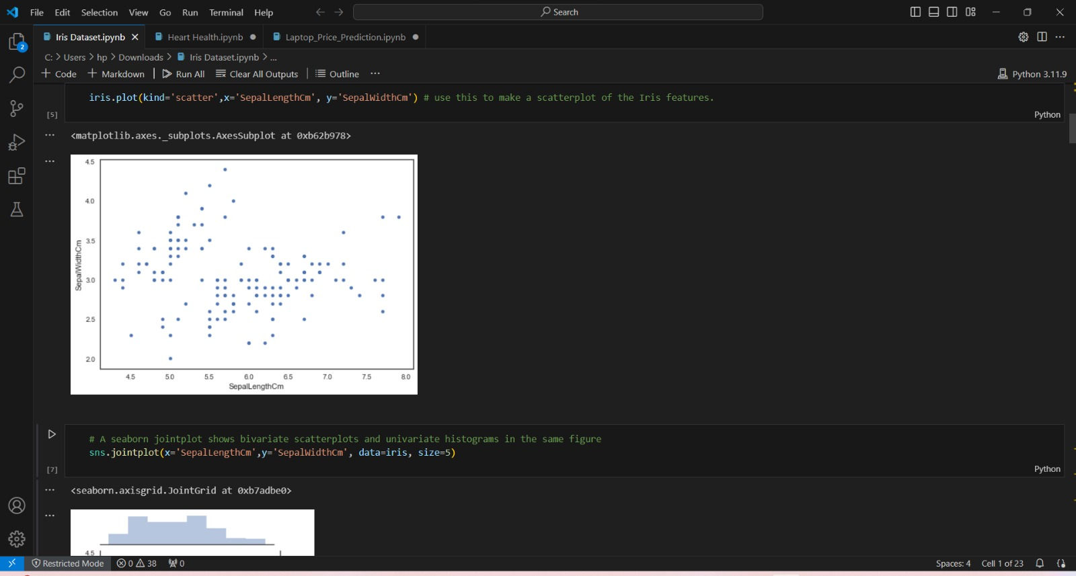
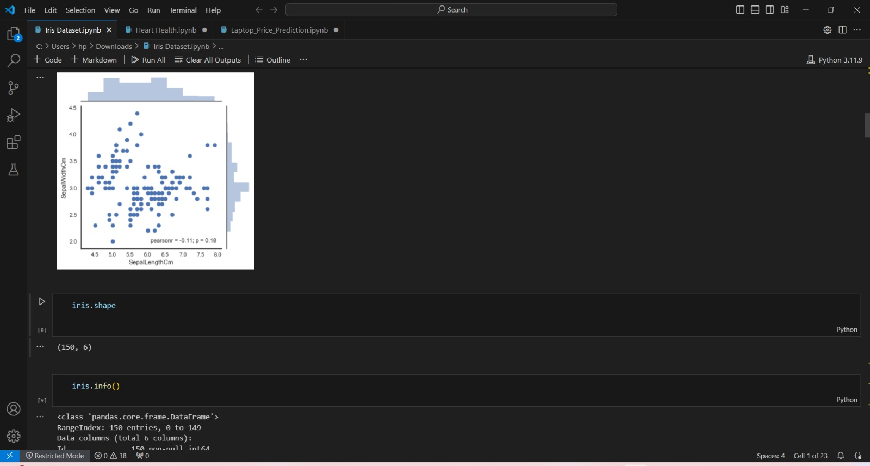
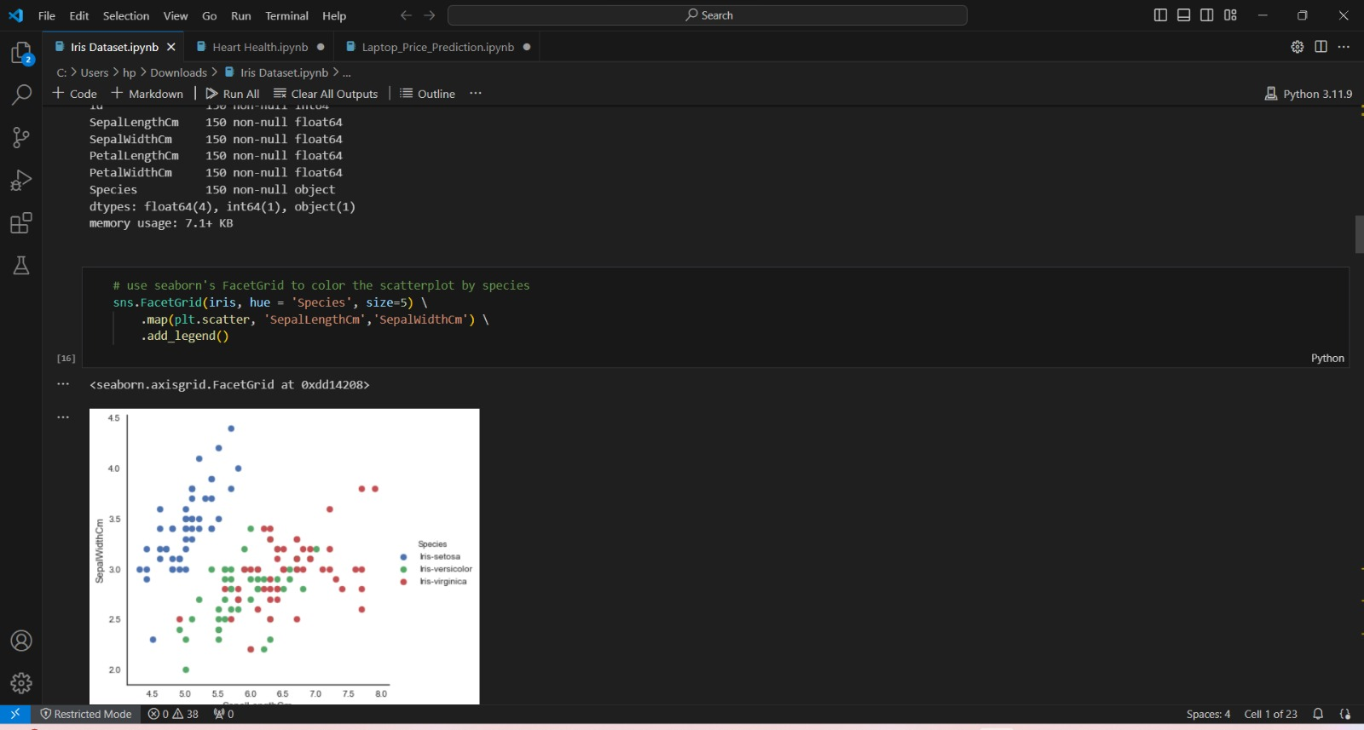
Result

Slide 9
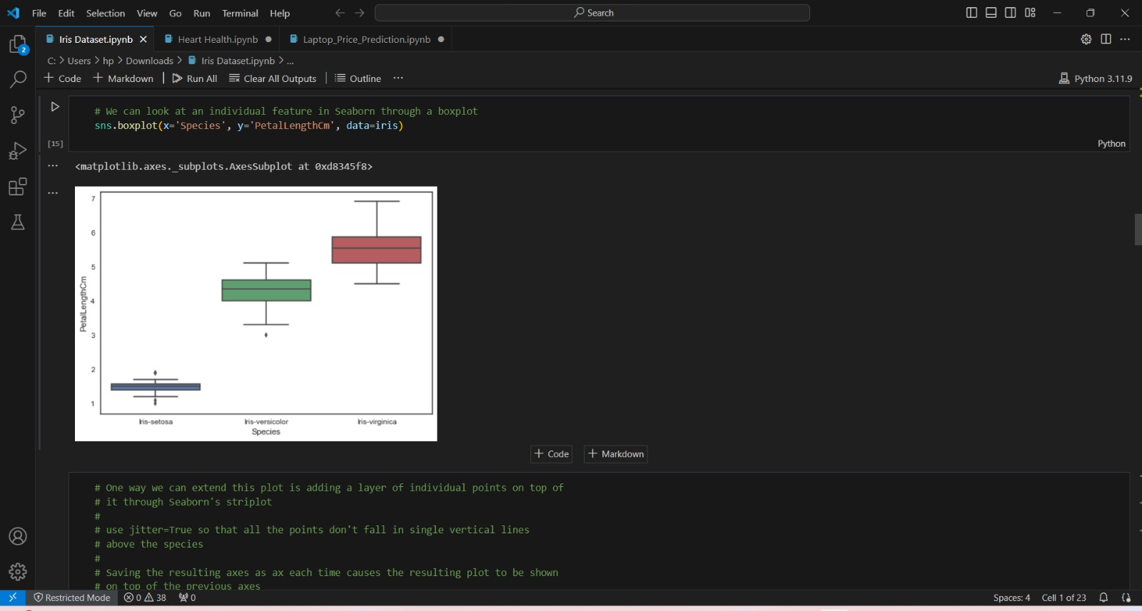
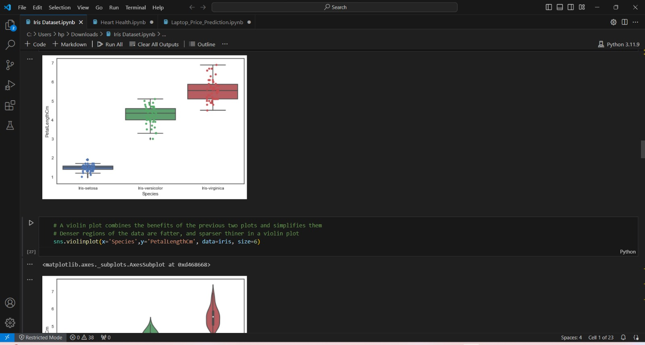
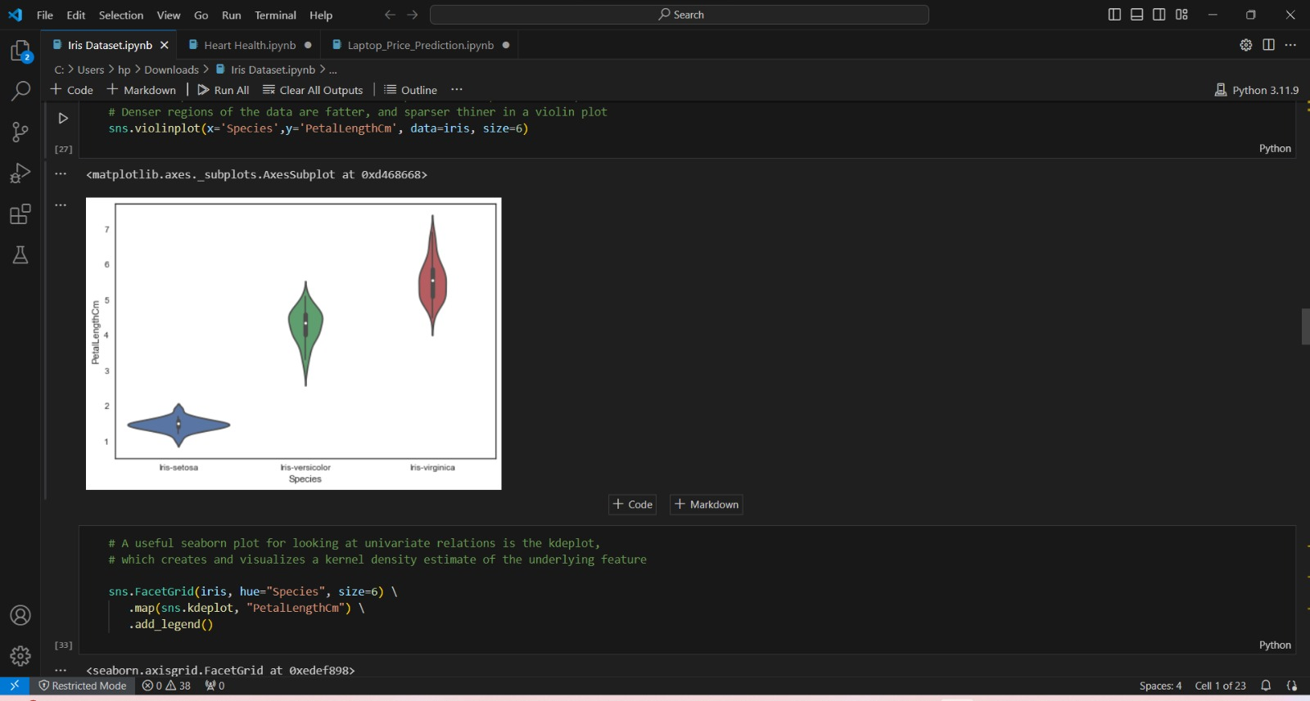
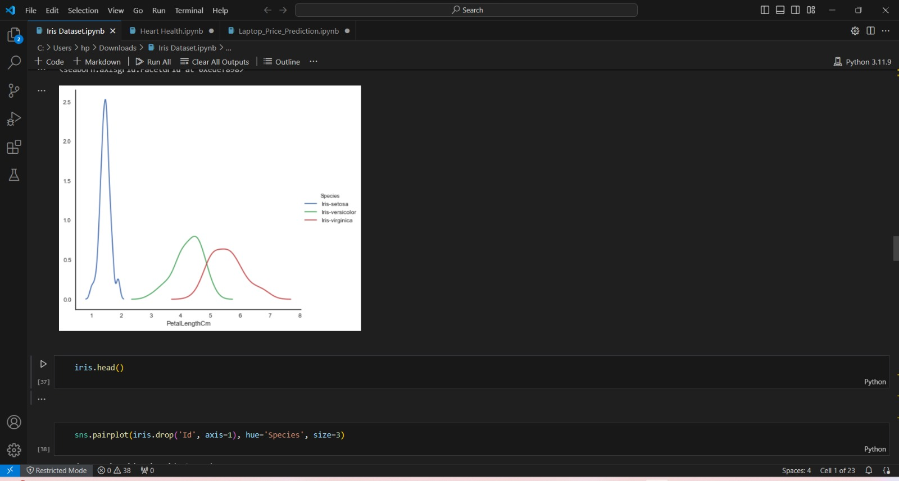

Slide 10
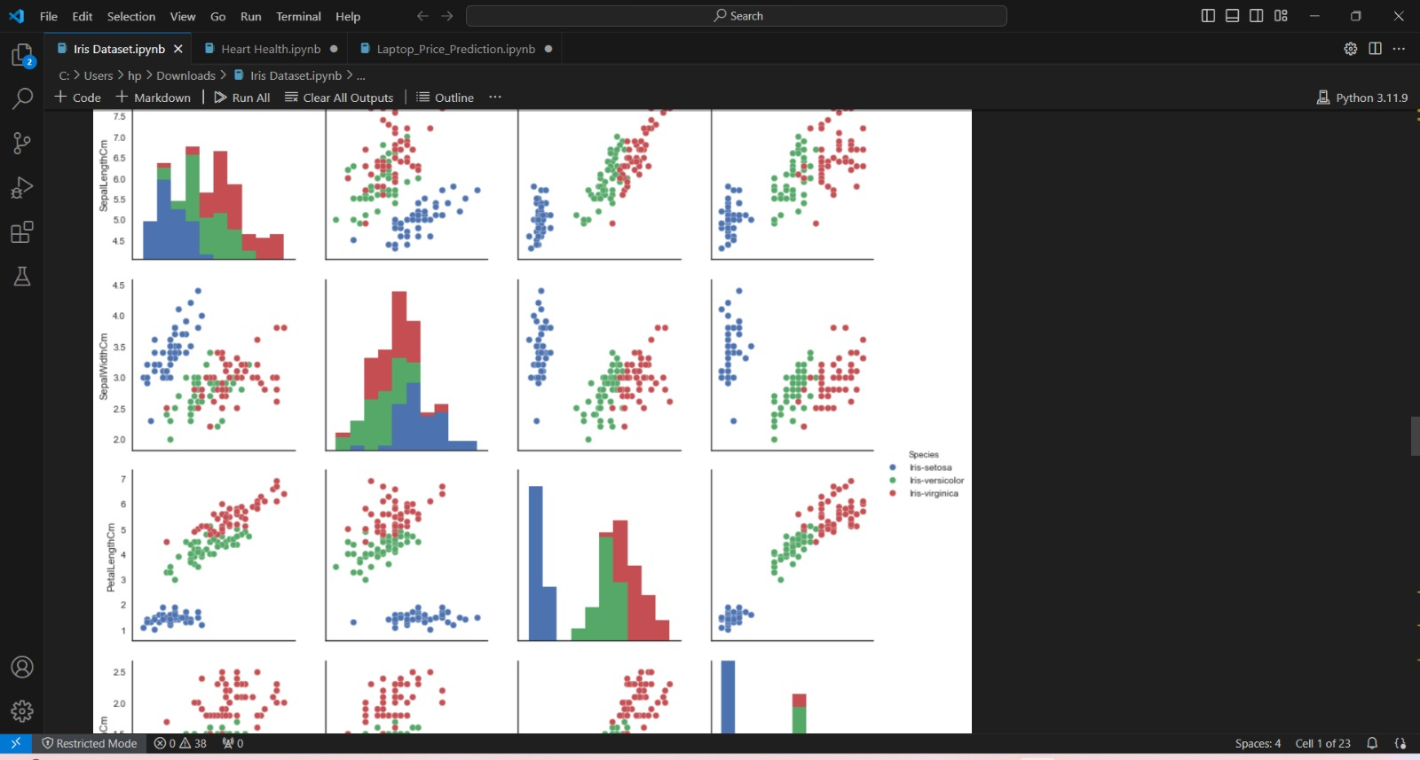
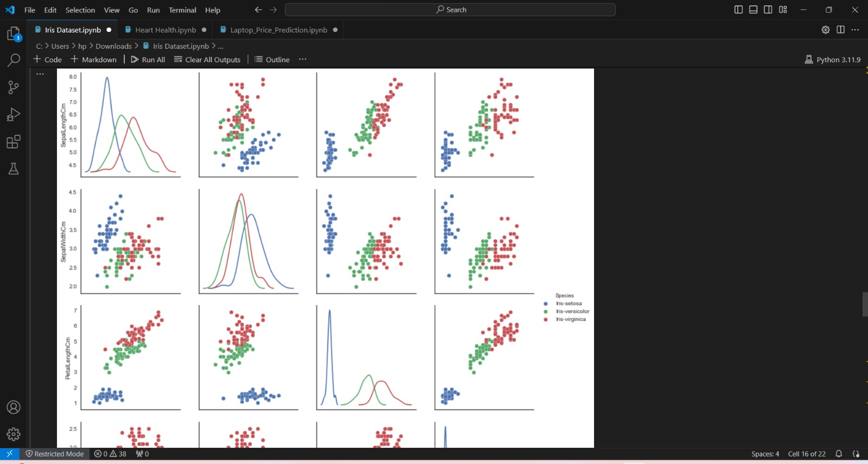
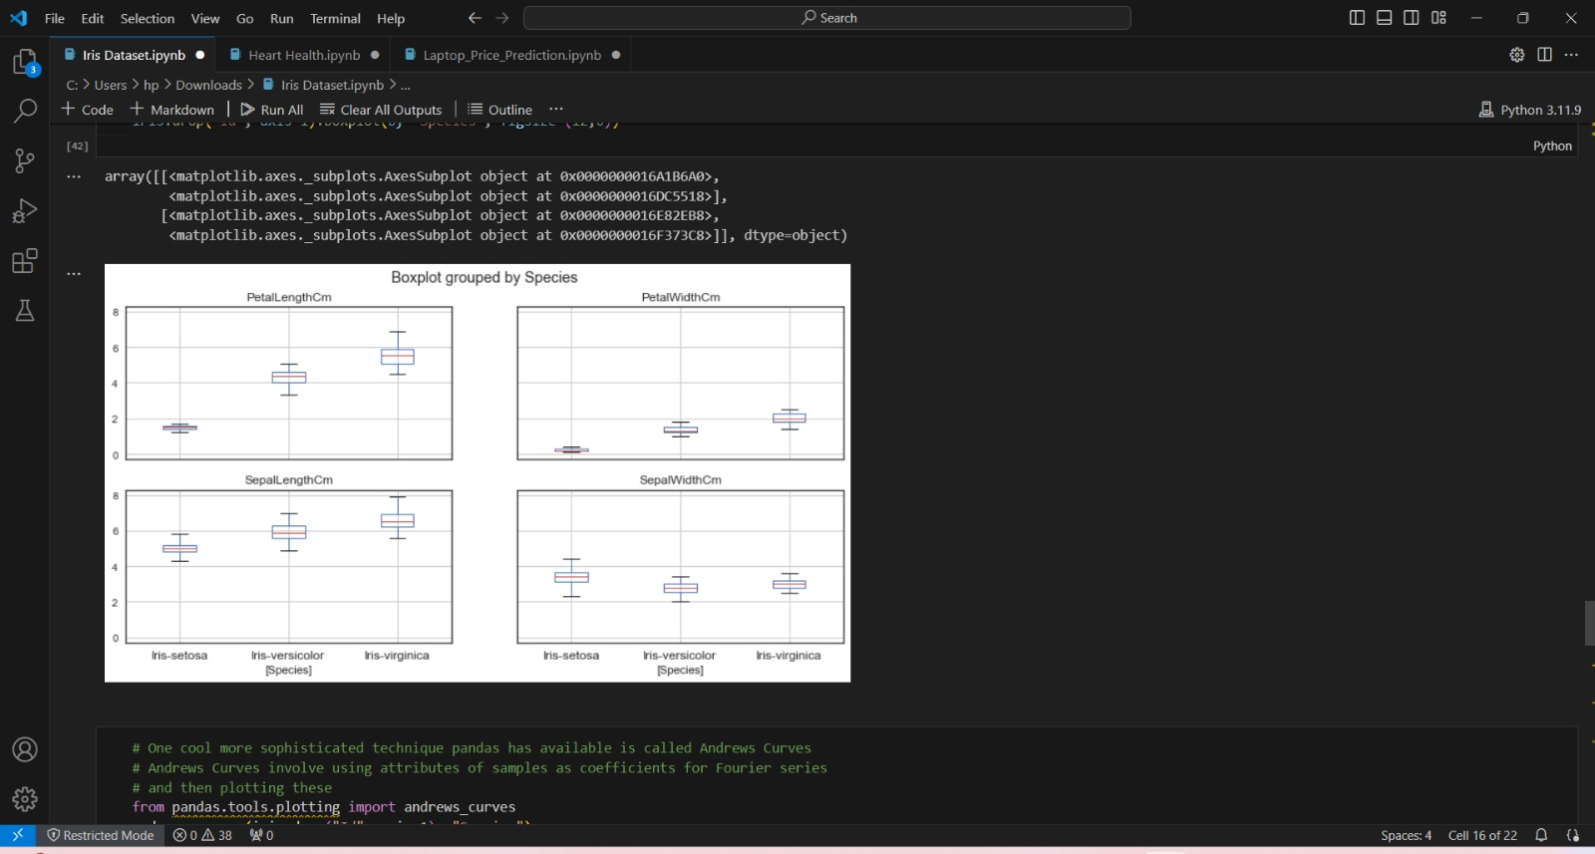
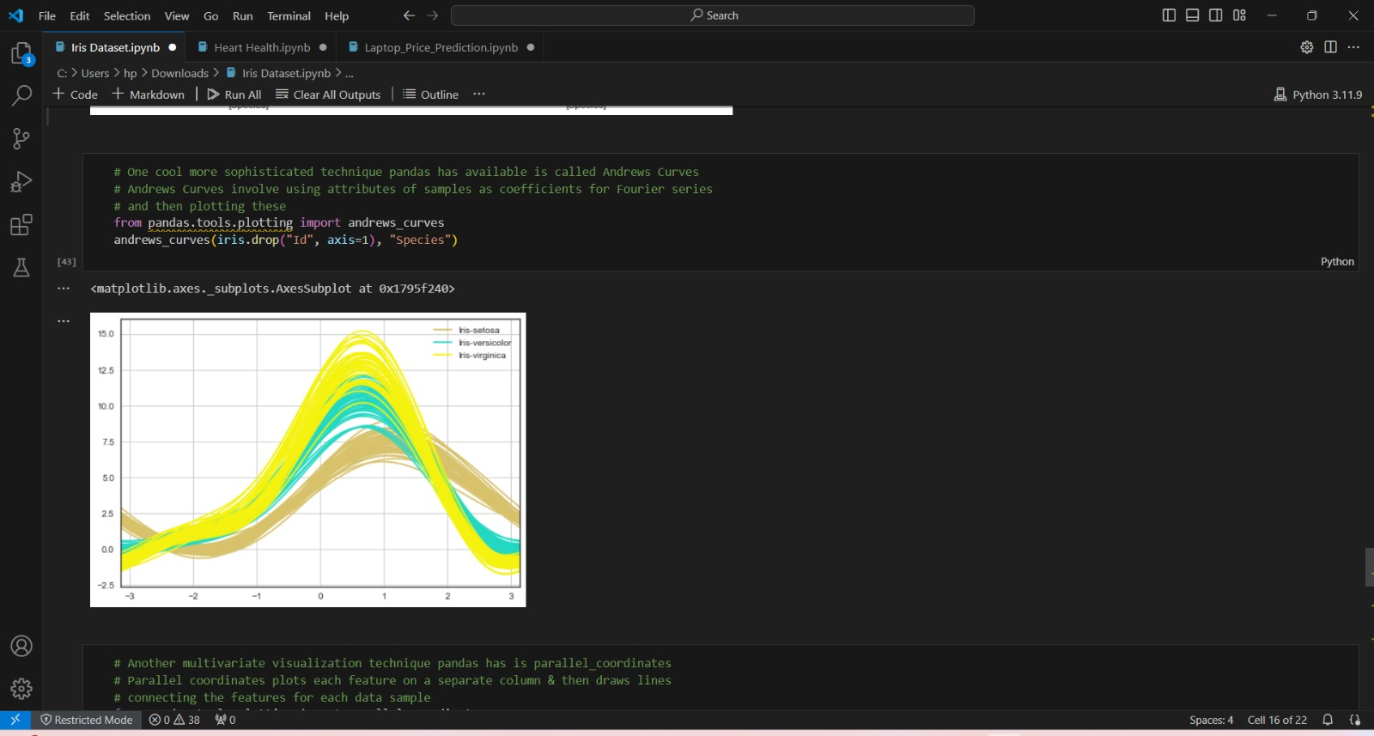

Slide 11
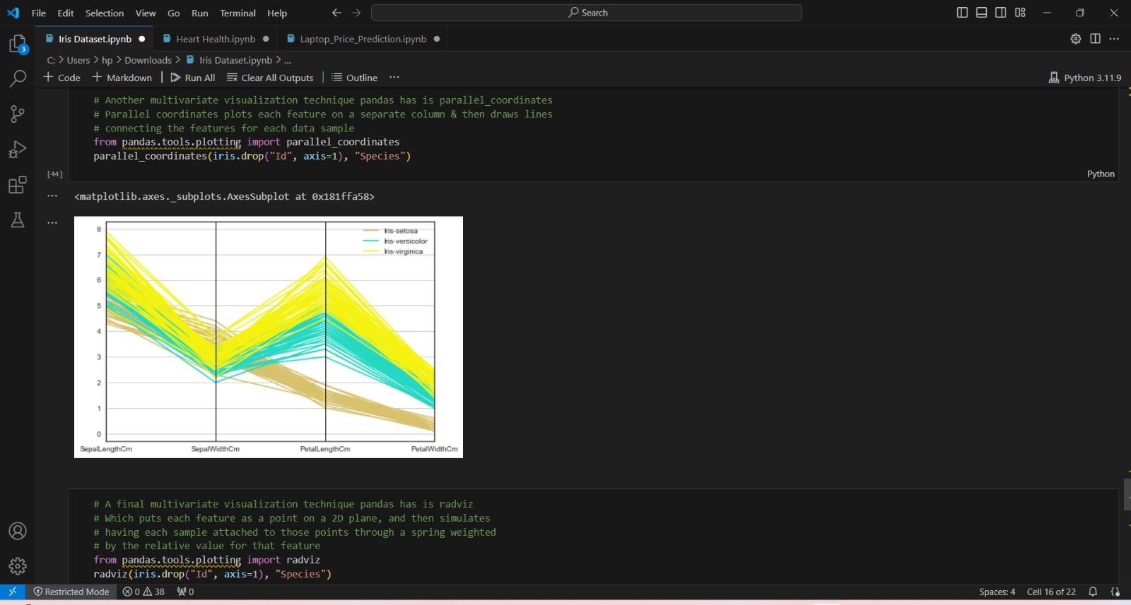
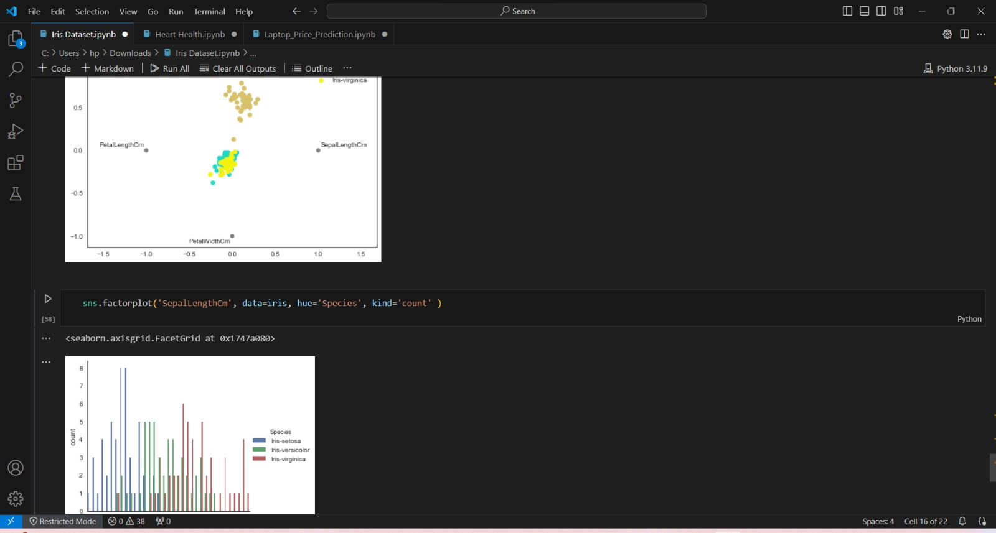

Slide 12
Conclusion
In conclusion, the Iris dataset serves as a fundamental benchmark in the field of machine learning and statistics, providing a simple yet effective platform for exploring classification algorithms and techniques. Through its 150 samples of iris flowers, each characterized by four features, the dataset presents a manageable yet diverse set of data for classification tasks.
Over the years, researchers and practitioners have extensively used the Iris dataset to evaluate the performance of various machine learning algorithms, ranging from classic techniques like logistic regression and decision trees to more advanced methods such as neural networks and gradient boosting machines. Its simplicity and well-defined nature make it an ideal starting point for studying classification problems, enabling novices to grasp fundamental concepts while offering seasoned professionals a reference point for benchmarking and experimentation.
Furthermore, the Iris dataset serves as a valuable educational resource, helping students and enthusiasts alike to understand key concepts in data preprocessing, model development, evaluation, and deployment. Its accessibility and versatility make it a staple in introductory courses and workshops on machine learning and data science.
In summary, while the Iris dataset may seem modest in scope, its significance extends far beyond its size. It stands as a timeless example of the power of data-driven approaches in solving real-world problems and continues to inspire curiosity, learning, and innovation in the ever-evolving landscape of machine learning and artificial intelligence.

Slide 13
Future scope
Here are some potential future directions and opportunities for the Iris dataset:
Advanced Modeling Techniques: As machine learning continues to evolve, researchers may explore more advanced modeling techniques, such as deep learning architectures, ensemble methods, and meta-learning approaches, to extract deeper insights from the Iris dataset. These techniques could uncover hidden patterns and relationships that traditional algorithms may overlook.
Feature Engineering and Selection: Future research could focus on refining feature engineering strategies and developing automated feature selection methods tailored to the characteristics of the Iris dataset. By identifying the most informative features and reducing dimensionality, models can become more efficient and effective.
Transfer Learning and Domain Adaptation: Researchers may investigate the applicability of transfer learning and domain adaptation techniques to the Iris dataset. By leveraging knowledge from related datasets or domains, models trained on the Iris dataset could generalize better to new tasks or environments with limited labeled data.
Data Augmentation and Synthesis: Data augmentation and synthesis techniques could be explored to generate additional synthetic samples for the Iris dataset, thereby enriching its diversity and improving model robustness. Synthetic data generation methods could help address class imbalance and enhance the dataset's representativeness.
Interdisciplinary Applications: Beyond traditional machine learning applications, the Iris dataset could find relevance in interdisciplinary fields such as computational biology, bioinformatics, and ecological modeling. Researchers may explore how machine learning techniques applied to floral classification could inform broader ecological studies or contribute to biodiversity conservation efforts.

Slide 14
References
Here are some references related to the Iris dataset:
Fisher, R.A. "The use of multiple measurements in taxonomic problems." Annals of Eugenics, 1936. This seminal paper introduces the Iris dataset and discusses its application in discriminant analysis.
Dua, D. and Graff, C. "UCI Machine Learning Repository." University of California, Irvine, School of Information and Computer Sciences, 2017. The Iris dataset is available for download from the UCI Machine Learning Repository, along with additional information and datasets.
Anderson, E. "The Irises of the Gaspe Peninsula." Bulletin of the American Iris Society, 1935. This publication describes the Iris flowers collected from the Gaspe Peninsula, which served as the basis for Fisher's dataset.
Scikit-learn Documentation. The scikit-learn Python library provides built-in functions to load and work with the Iris dataset, along with examples and documentation.
R Core Team. "iris - Flower Iris Data Set." R Documentation, 2021. The R programming language includes the Iris dataset as a built-in dataset, with documentation available for usage and exploration.
These references provide foundational information, access to the dataset, and insights into its historical context and applications in machine learning research and education.

Slide 15
THANK YOU

